Slide 1



CPS3320 W03
Temperature
Prediction
Group Members:
Chen Leyan 1129982
Yin Ning 1129786

Slide 2

CONTENT
01. Introduction
03. Code
02. Data
04. Conclusion

Slide 3

01
INTRODUCTION

Slide 4
Temperature prediction
Climate change has a great impact on people's production and life, and weather forecasting technology is necessary and important.
Build a neural network model through Python for Temperature regression prediction.

Slide 5
02
DATA

Slide 6
National Aeronautics and Space Administration
Goddard Institute for Space Studies
The NASA Goddard Institute for Space Studies (GISS) is a laboratory in the Earth Sciences Division (ESD) of National Aeronautics and Space Administration's Goddard Space Flight Center (GSFC). The ESD is part of GSFC's Sciences and Exploration Directorate.
The GISS Surface Temperature Analysis ver. 4 (GISTEMP v4) is an estimate of global surface temperature change. Graphs and tables are updated around the middle of every month using current data files from NOAA GHCN v4 (meteorological stations) and ERSST v5 (ocean areas)
Reference: https://data.giss.nasa.gov/gistemp/

Slide 7
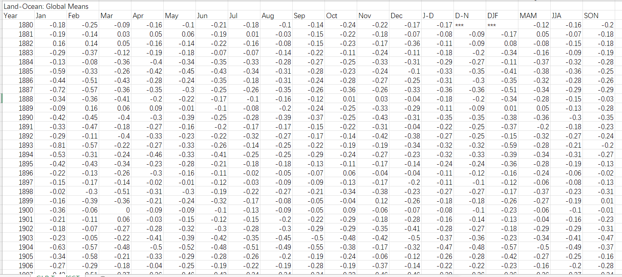

Slide 8
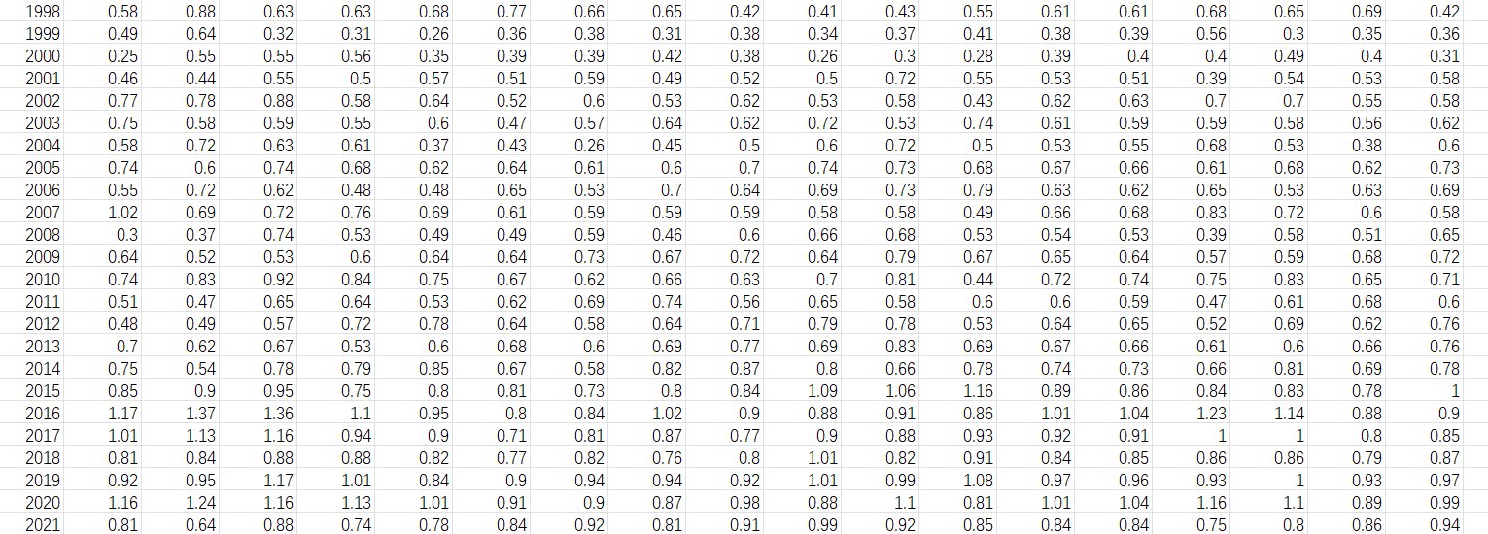

Slide 9
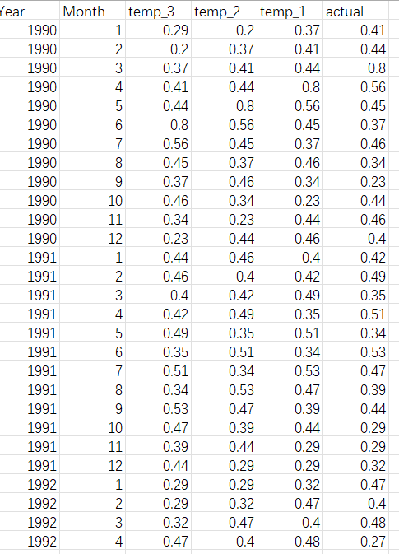
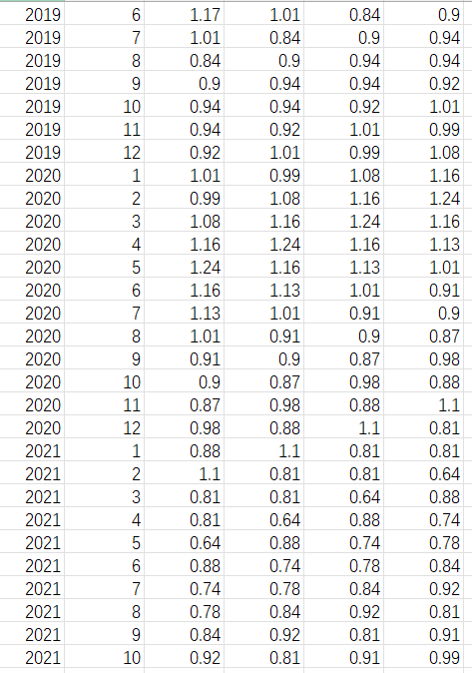

Slide 10
03
CODE

Slide 11
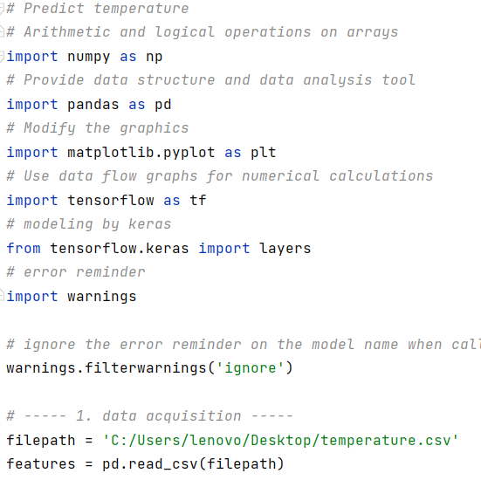

Slide 12
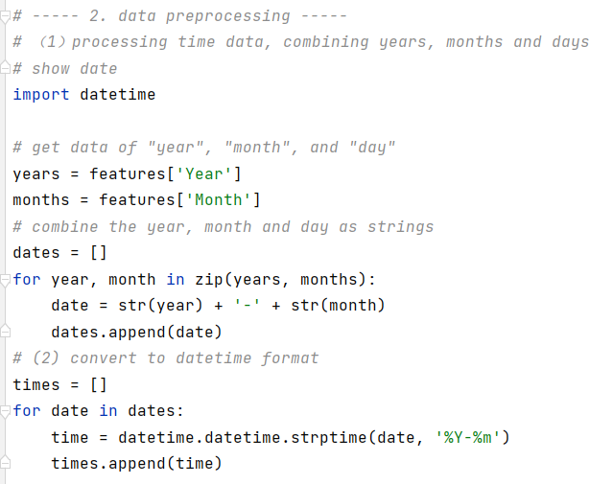

Slide 13
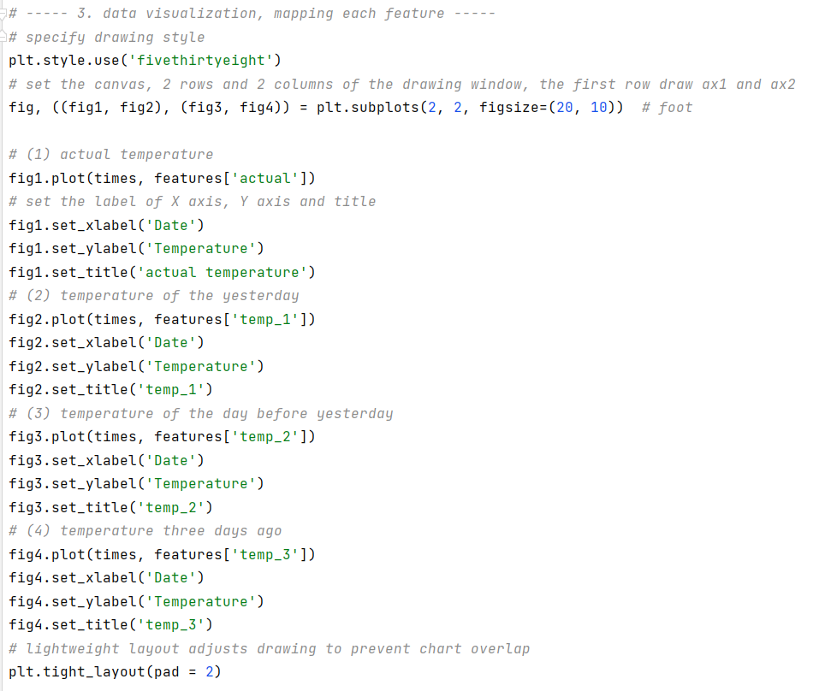
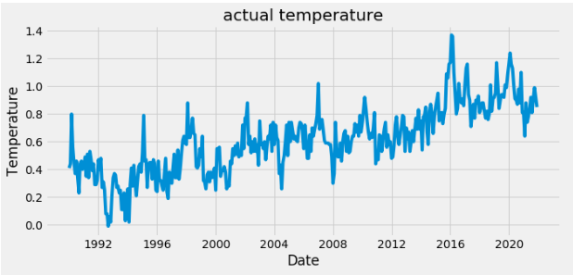

Slide 14
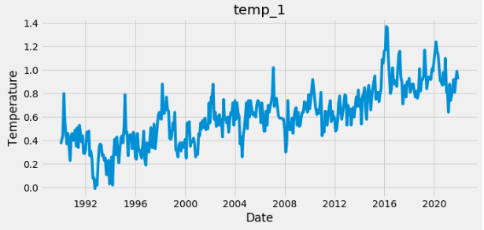

Slide 15
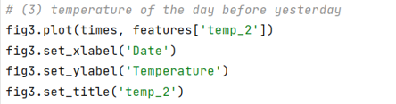
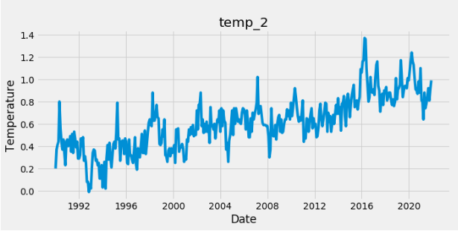

Slide 16
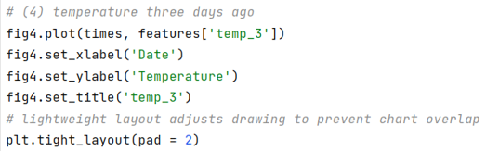
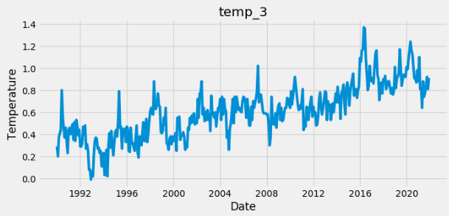

Slide 17
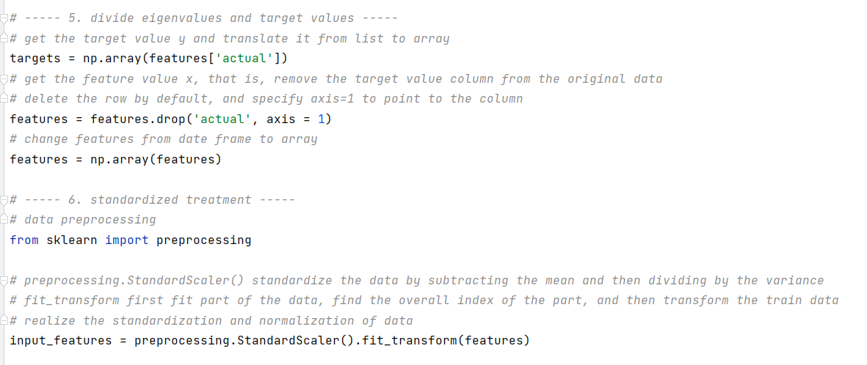

Slide 18
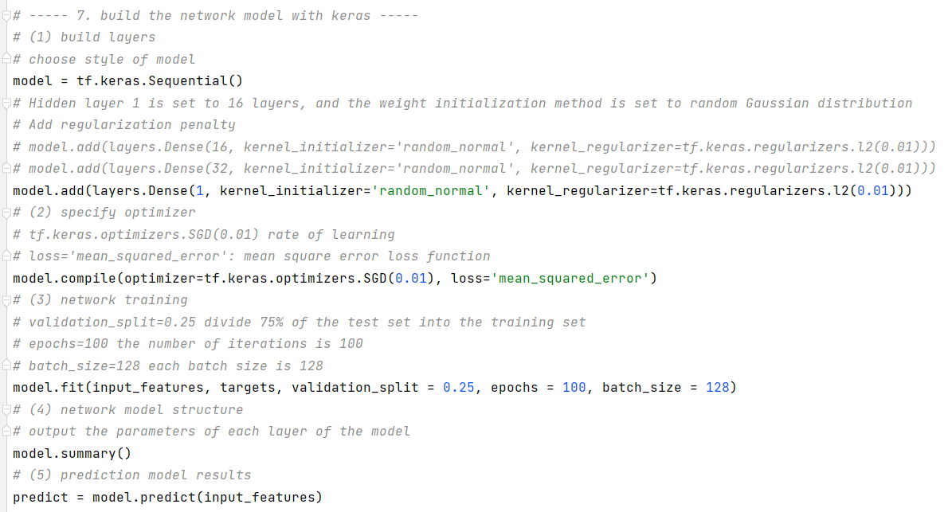

Slide 19
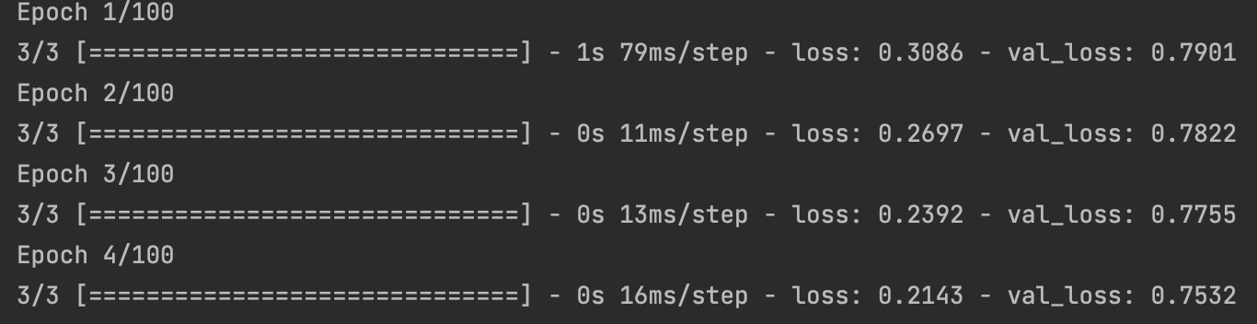

Slide 20
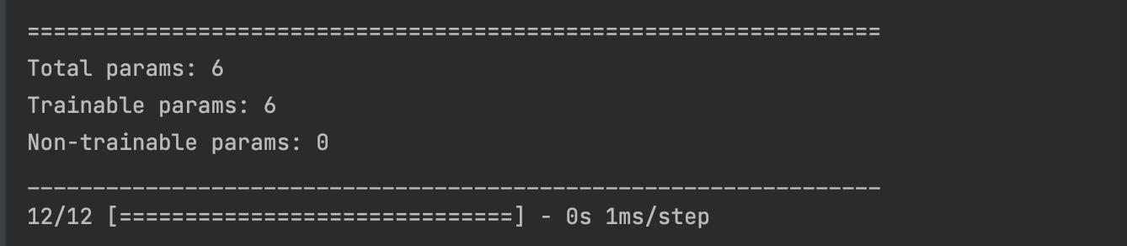

Slide 21
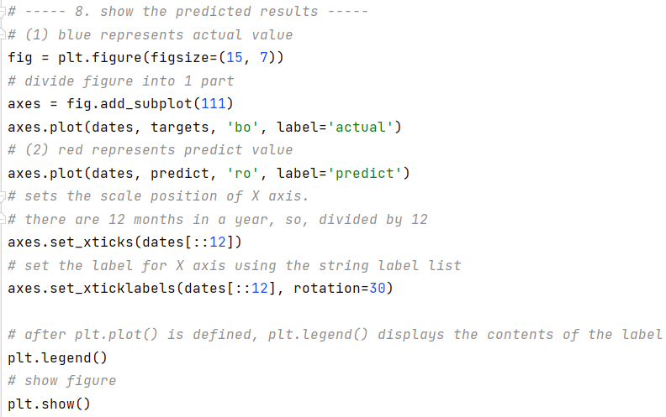
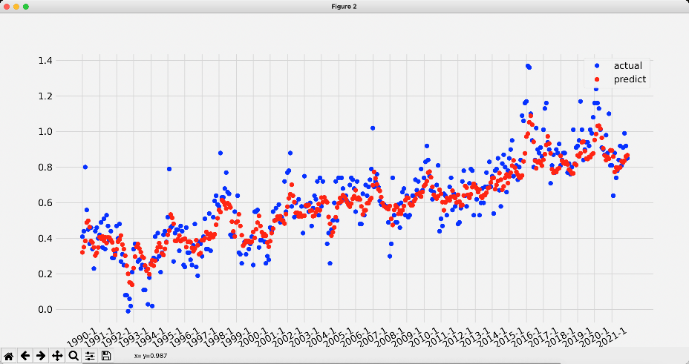

Slide 22


Slide 23
04
CONCLUSION

Slide 24
CPS3320
Thanks For Listening
Group Members:
Chen Leyan 1129982
Yin Ning 1129786

